Slide 1
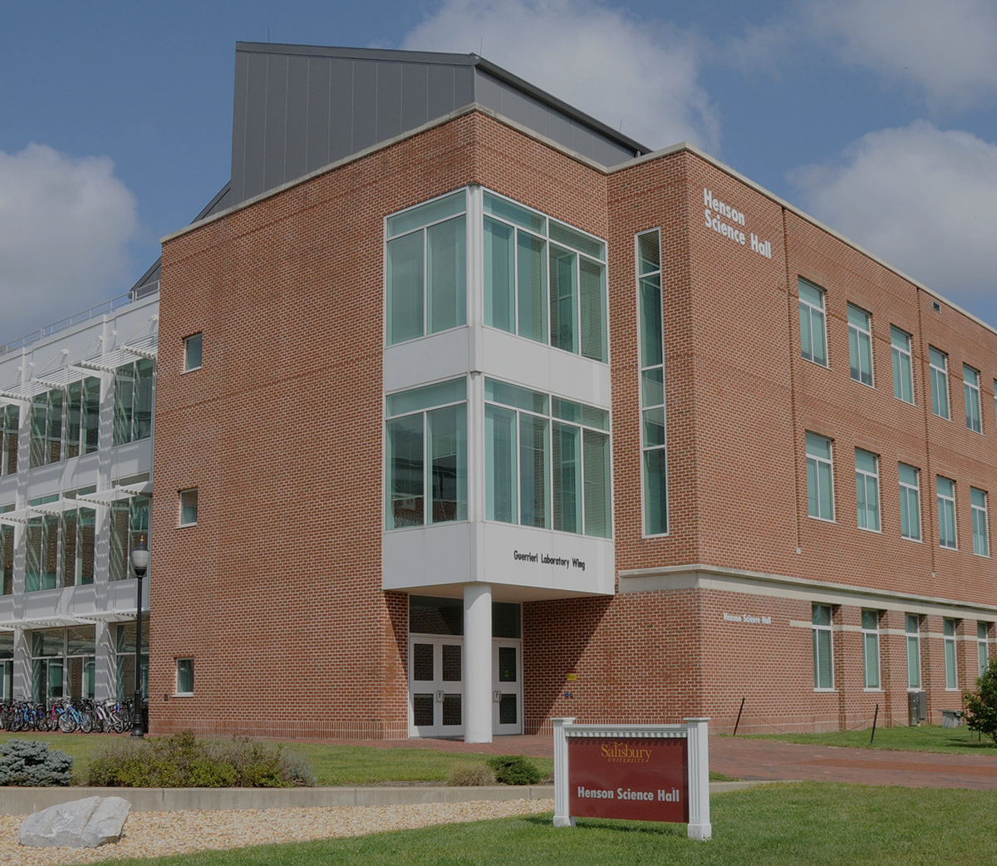
SU Hacks Salisbury’s First Ever Hackathon
Introducing
Presented by JJ McCauley
Junior Computer Science Student

Slide 2
01
What is a Hackathon?
02
Motivations & Goals
TABLE OF CONTENTS
03
Preliminary Logistics
04
Website
05
Department Involvement

Slide 3
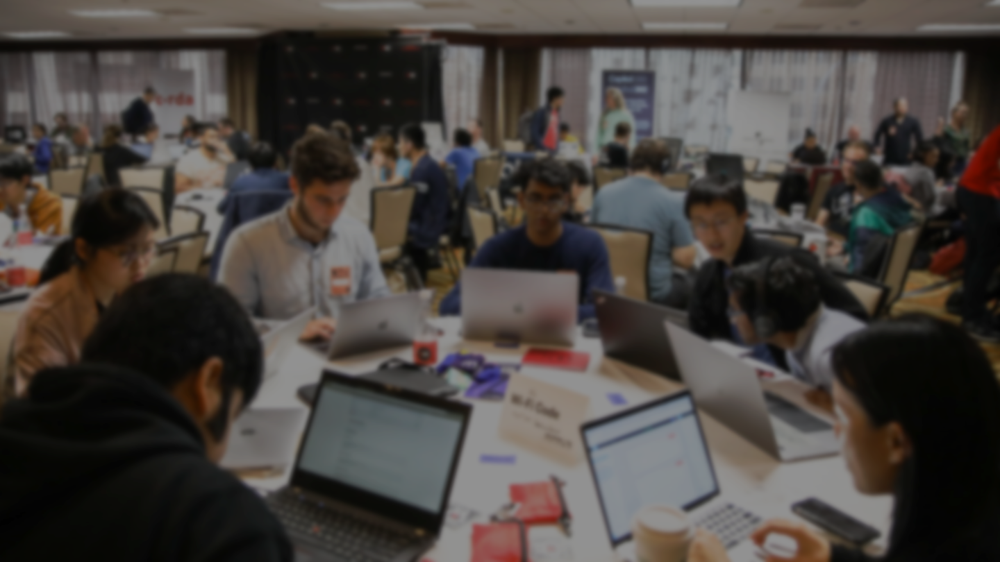

What is a Hackathon?
Coding & Problem-solving Competition
Teams create projects within 12 hours
Often includes prizes, mentorship, and workshops
Notes:
A hackathon is a time-limited event where individuals or teams collaborate to develop innovative projects, typically related to software or technology. “Creative Marathon”

Slide 4






HOPHACKS
BisonBytes
Bitcamp
OTHER UNIVERSITY-BACKED HACKATHONS
HackUMBC
HackPSU
Hoya Hacks
Johns Hopkins University
Baltimore, MD
Howard University
Washington, DC
University of Maryland
College Park, MD
UMBC
Baltimore, MD
Penn State University
University Park, PA
Georgetown University
Washington, DC

Slide 5
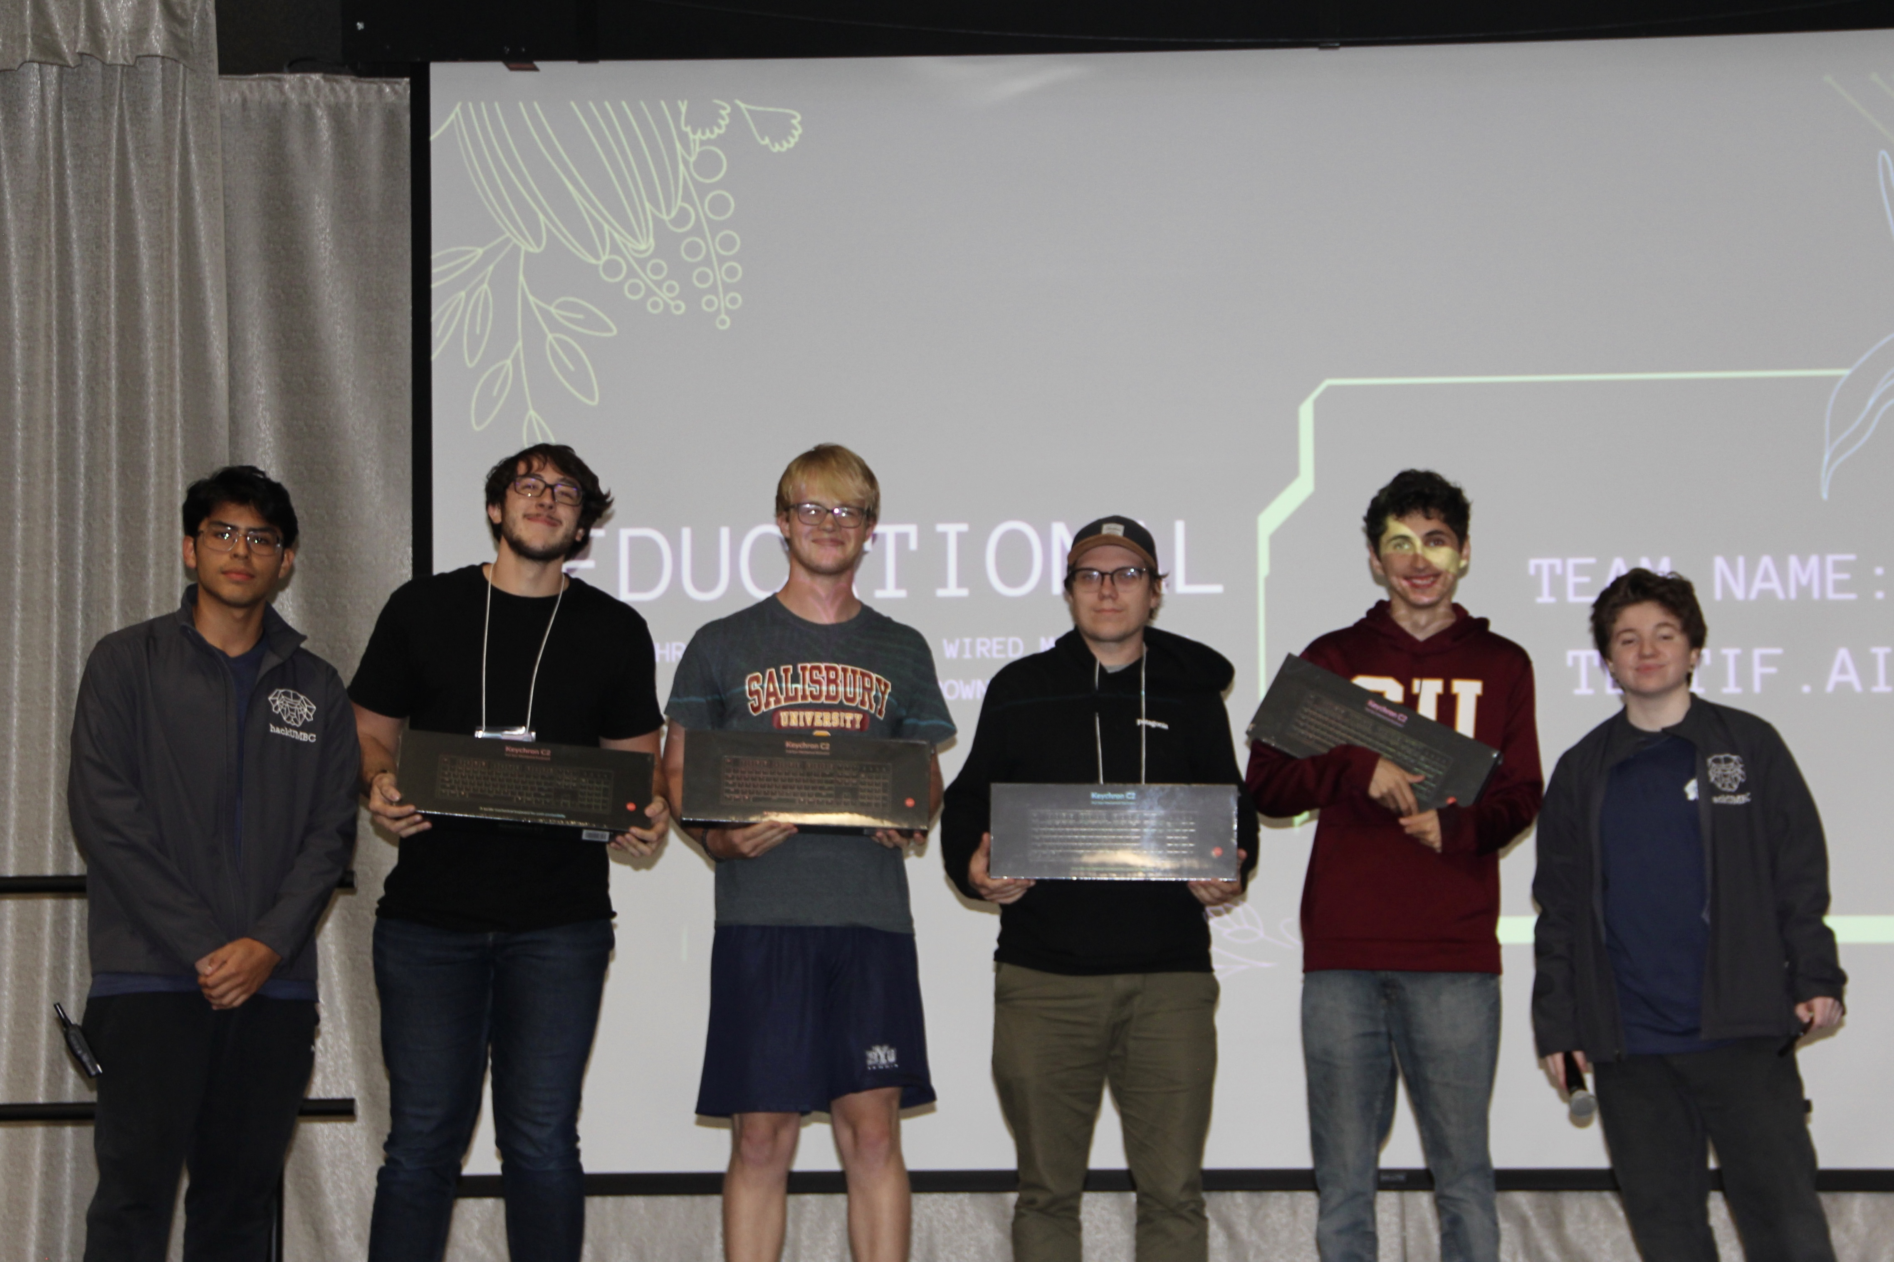
PERSONAL MOTIVATIONS
LEARNING
CONFIDENCE
NETWORKING
Unlike any classroom experience. Very industry-like, on your feet and learning as you do.
Reinforces student’s ability with high-pressure situations
Many employers and other helpful students

Slide 6
Enhancing Student Learning
Boosting University Reputation
HACKATHON GOALS
Improving Student Engagement
Driving Research & Innovation
Hands-on experiences, helping students develop industry skills that may not found as much in the classroom
Well-executed Hackathons attracts attention from various companies, recruiters, sponsors, and prospective students
Brings together students, alumni, mentors, and others to foster a positive and collaborate environment
Hackathons serve as a testing ground for new ideas, many of which could evolve into university-backed startup initiatives

Slide 7
Oct. 25th, 2025
EVENT DATE
GENERAL LOGISTICS
12-Hours
HACKATHON DURATION
Henson
Building Venue

Slide 8
TIMELINE
Late April
Early Oct.
Venues are locked, initial sponsors are confirmed, and budget is finalized
Aggresive event marketing, Sponsor cutoff date, merch and other resources are obtained
Early April
Early Fall
Oct. 25th
Website is finalized and published; Interest forms are made publicly available
Offical registration opens, event marketing begins
Day of Hackathon Event!

Slide 9
WEBSITE PREVIEW
Preview of the SU Hacks Website, developed in conjunction with the SU webmasters via Wordpress. This ensures that the website can run on SU servers, and that future organizers can easily edit and expand upon the website

Slide 10

Judging
Mentorship
DEPARTMENT INVOLVEMENT
Workshops
Promotion
Evaluate projects based on innovation and execution
Guide students with technical and project advice
Give specialized talks in areas such as AI, web dev, or cybersecurity
Encourage students to attend, promoting the event in class

Slide 11
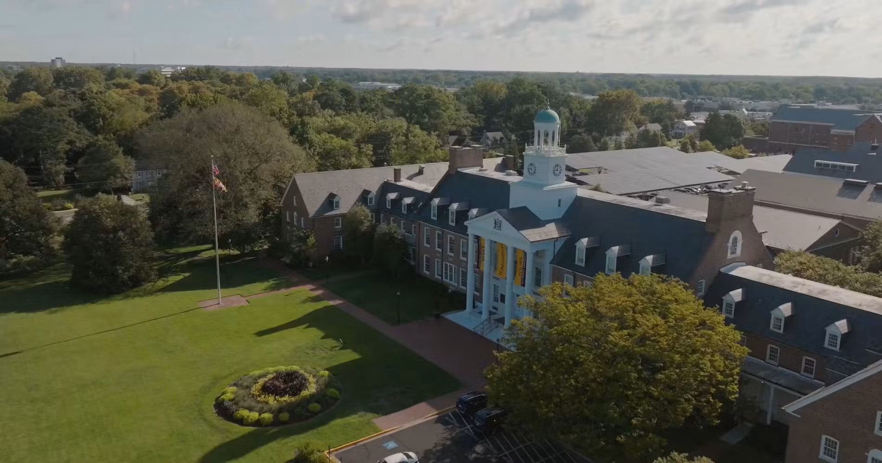
Thank you!
For questions, suggestions, or volunteer inquiries, feel free to contact me at:
jmccauley4@gulls.Salisbury.edu Hackathon@salisbury.edu

